Slide 1

NPRM 2025
Magnetic Hyperthermia Effect and Equilibrium Susceptibility in Core–Shell Fe–Fe₃C Nanoparticles
Harutyun Gyulasaryan
Institute for Physical Research, NAS of Armenia
E-mail: gharut1989@gmail.com

Slide 2
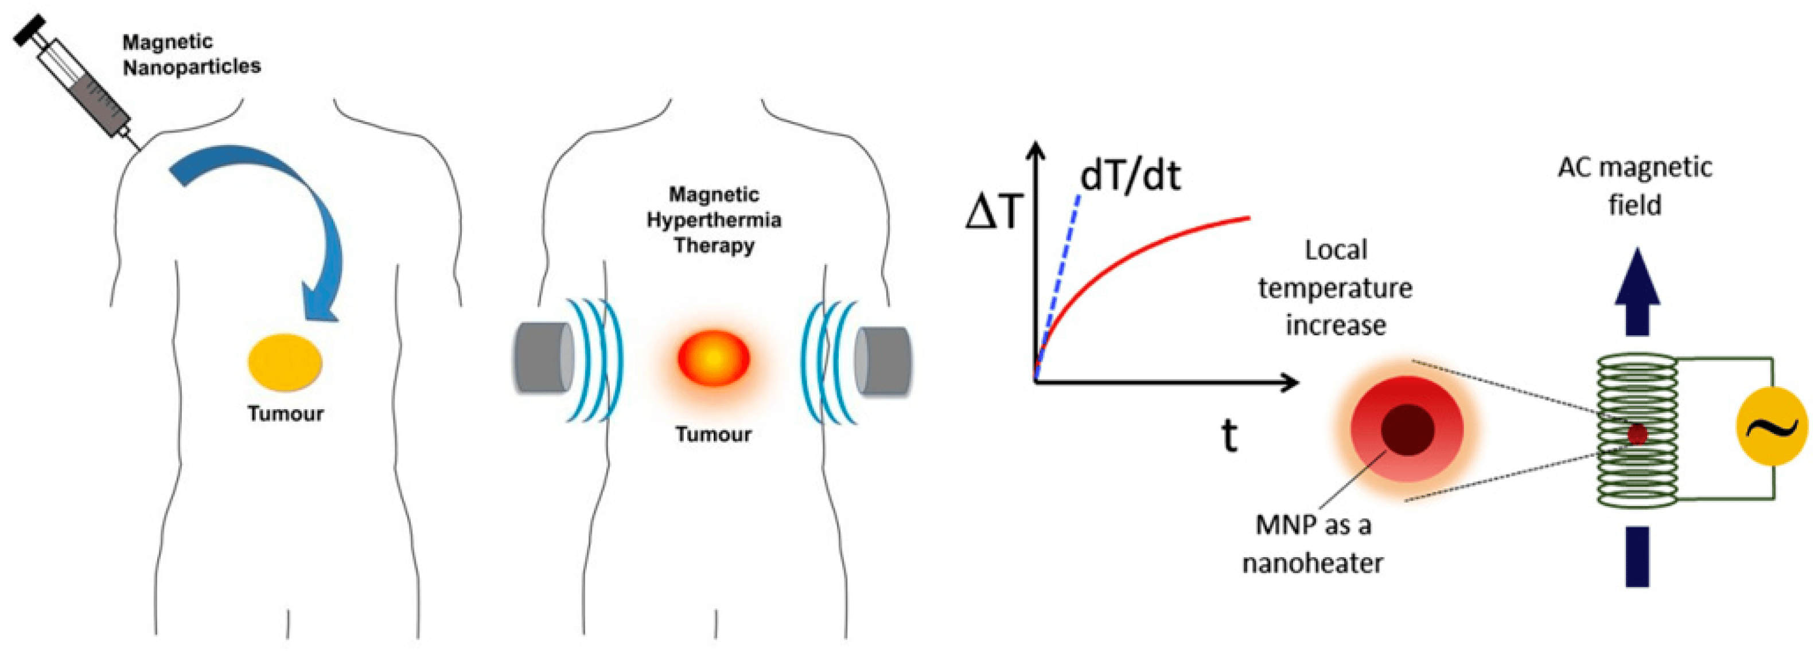
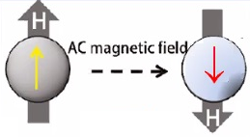
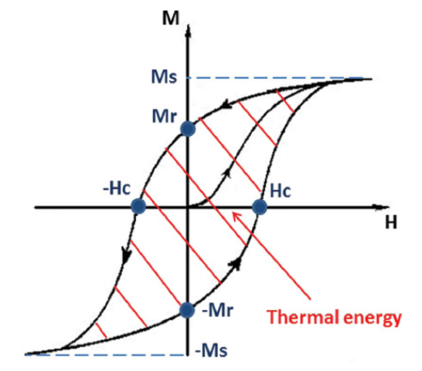
NPRM 2025
Magnetic Particle Hyperthermia
Applied magnetic field
Frequency | Amplitude
100-1000 kHz | 10-100 kA/m
Notes:
Magnetic Particle Hyperthermia (MPH) is an emerging technique for cancer treatment. In this technique, MNPs are prepared as a water-stable colloidal suspension that is injected into the specific tumor location. When submitted to an alternating magnetic field with physiological safe frequency and amplitude, the nanoparticles release heat due to magnetic relaxation (Néel or Brownian) or hysteresis losses. If localized heating is enough to increase the temperature of the tumor region to the range of 42–46 °C, tumor cells can be killed without damaging the surrounding healthy tissues

Slide 3
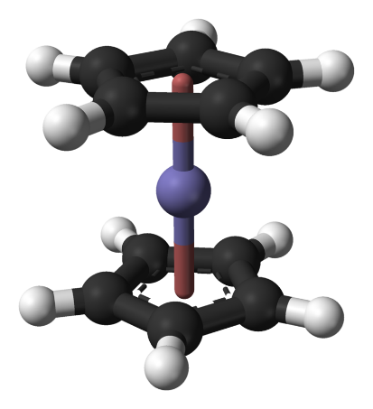
NPRM 2025
Synthesis of Fe-Fe₃C core-shell nanoparticles
Ferrocene
Carbon
C
Fe₃C
Fe
C
Fe
C
Fe₃C
Fe
Fe
C
C
Fe₃C
Fe
Fe
C
Fe clusters
1.
2.
Temperature T_{pyr} = 750º C
Time t_{pyr} = 40 min
Pressure p_{pyr} = ~ 1 MPa
Mixed concentration of metal (Fe-Fe₃C) will be in range $≈$32-34 wt.%
Notes:
For this aim Fe–Fe₃C core–shell nanoparticles in a carbon matrix were synthesized by solid-phase pyrolysis of ferrocene. The pyrolysis reaction can be represented by the first reaction scheme.
The initial stage of pyrolysis leads to the formation of iron clusters within the carbon matrix. During the subsequent growth of iron nanoparticles, surface atoms interact with carbon atoms to form iron carbide (Fe₃C), and this process can be described by the second reaction scheme. In the synthesized material, the iron–cementite fraction is approximately 32–34 wt%.

Slide 4
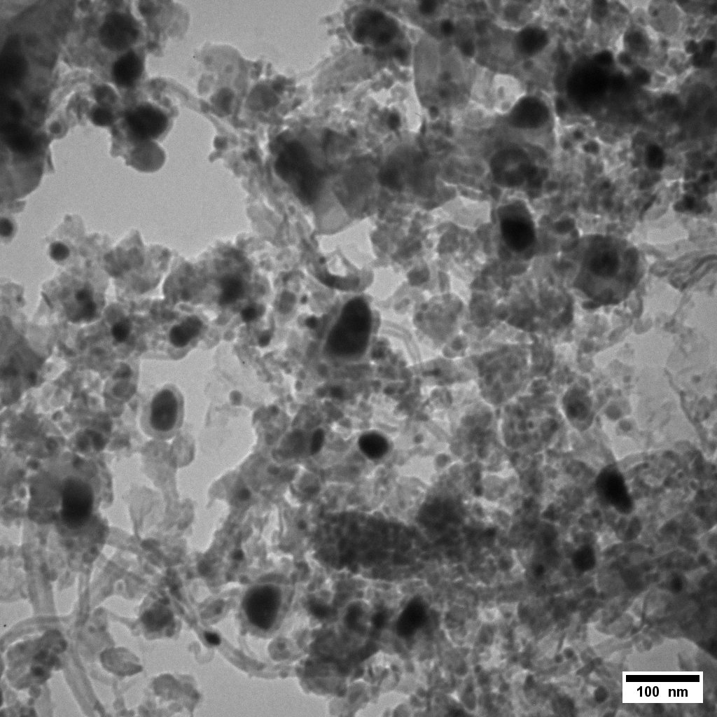
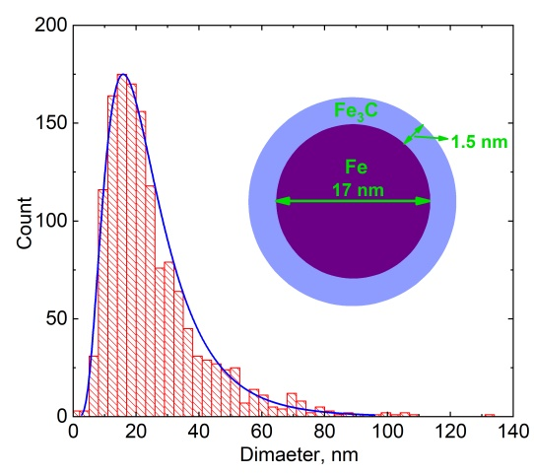
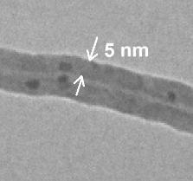
SEM and TEM images of Fe-Fe₃C Core-shell nanoparticles
NPRM 2025
Notes:
Electron microscopy images reveal that the synthesized nanoparticles exhibit a near-spherical shape and relatively broad size distribution with
a mean diameter of 20 nm.
Additionally, the nanocomposite contains hollow carbon nanotubes with the wall thickness ~5 nm.

Slide 5
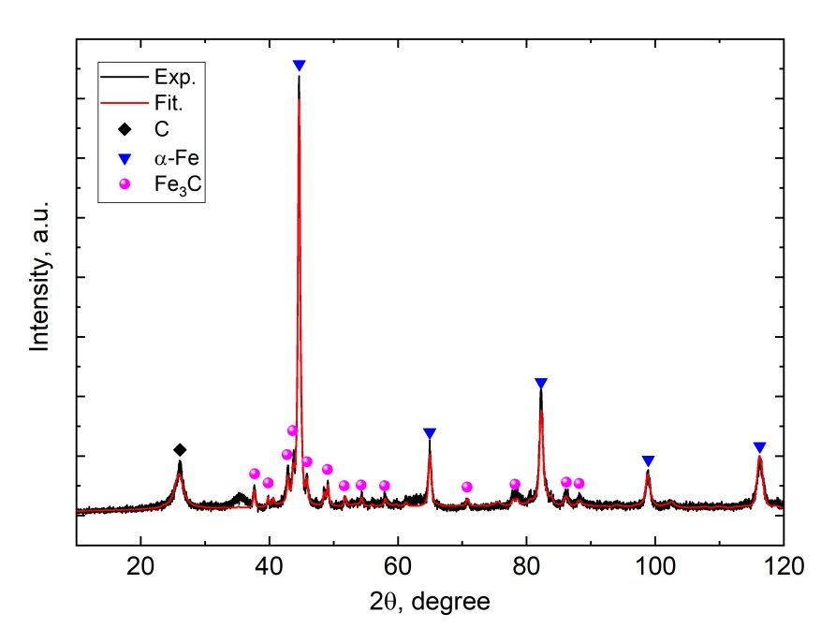
NPRM 2025
Phase composition of synthesized material
Phase | Fraction wt. % | Crystallinity size, nm | Cell Parameters, Å
Fe₃C, Pnma | 12 ± 1 | 22 | a = 5.09 [5.085]*
 |  |  | b = 6.75 [6.736]
 |  |  | c = 4.53 [4.514]
Fe, Im3m | 23 ± 1 | 20 | a = 2.87 [2.867]
Carbon, P63mc | 65 ± 2 | 6.5±0.1 | c = 6.87 [6.696]
Phase weight ratio
Fe : Fe₃C ≈ 2:1
Notes:
Figure displays the XRD pattern of the synthesized material. Rietveld refinement of the pattern revealed the
presence of three phases: Fe3C, carbon and cubic α-Fe. The broad peak at around 2θ ∼ 26° corresponds to the graphite matrix.
Full-profile fit provides 2:1 weight ratio between the iron and Fe3C:
It should also be noted that the crystallite sizes estimated from the analysis are consistent with the particle sizes obtained from electron microscopy.

Slide 6
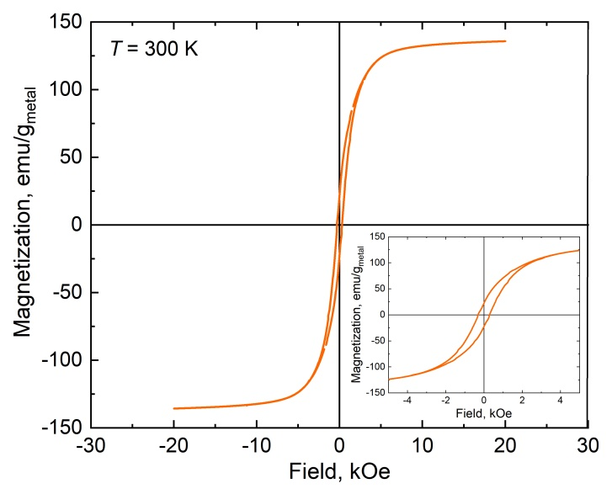
NPRM 2025
The room temperature magnetization
$$M_{S}^{\left(tot\right)}\left(T\right)=x\%∙M_{S}^{\left(Fe\right)}\left(T\right)+\left(100−x\right)\%∙M_{S}^{\left(Fe_{3}C\right)}\left(T\right)$$
M_{s} ~ 135 emu/g_{metal}
H_{c} ~ 287 Oe
Notes:
The field dependence curve of the magnetization at room temperature for fabricated powder confirms the ferromagnetic behaviour of the sample. Given that the magnetism of carbon is negligible, the total saturation magnetization is normalized to the magnetic metal fraction giving magnetic saturation Ms ~ 135 emu/gmetal and the coercivity ~ 287 Oe. In general, the total saturation magnetization is the sum of the average saturation magnetizations of Fe and Fe3C.

Slide 7
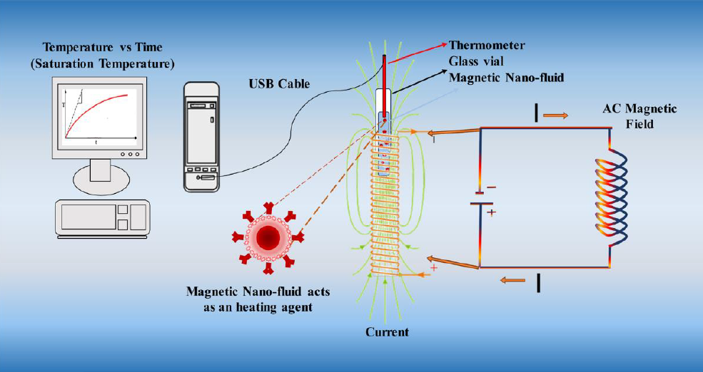
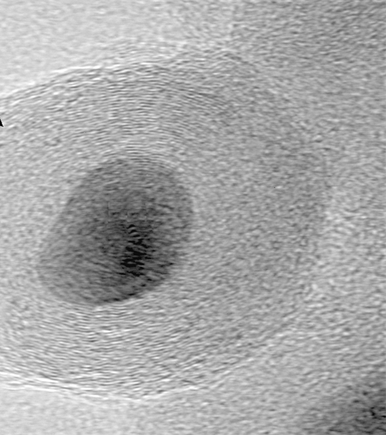
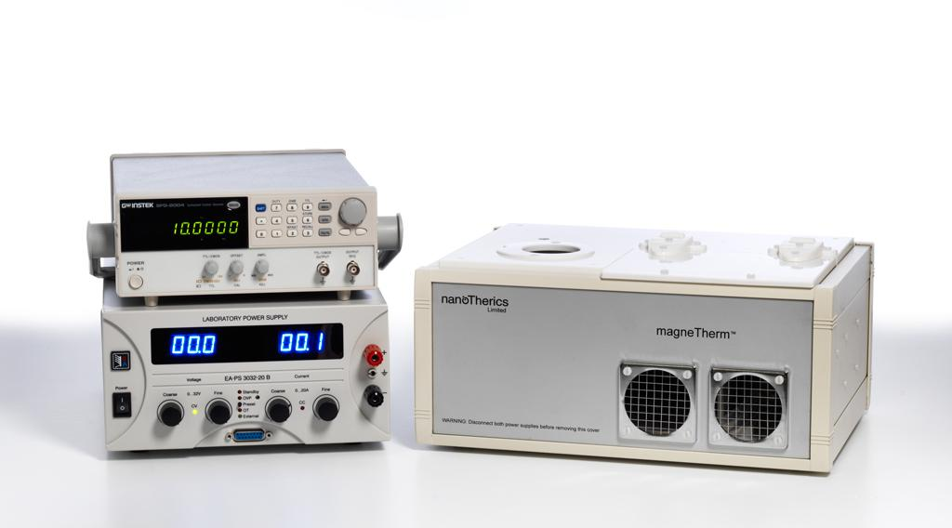
NPRM 2025
Hyperthermia device and Measurement
Thermometer
Glass vial
Water solution
Fe-Fe₃C Magnetic Nanoparticles
Z. Hedayatnasab, et al.,, Materials & Design 123 (2017) 174–196.
Notes:
For magnetic particle hyperthermia the basic technical parameter in material characterization is Specific Loss Power which is calculated as the power absorption per unit mass of magnetic material and can be calculated based on equation.
To evaluate the heating performance and the corresponding specific loss power (SLP), a suspension containing 4 mg of magnetic nanoparticles (MNPs) in 1 mL of distilled water was prepared. This suspension was then subjected to an alternating magnetic field with varying parameters, specifically amplitude and frequency.
The magnetocaloric properties were studied using a MagneTherm magnetic hyperthermia device. Temperature measurements during the experiment were conducted using a fibre optic sensor.
ΔT /Δt is the heating rate that can be determined from initial slope of the heating curve.
There are many factors which alter the SLP values, Sizs, shape, composition, viscosity, magnetic properties and field parameters. Several theoretical frameworks have been developed to evaluate and optimize the heating performance of magnetic nanoparticles.

Slide 8
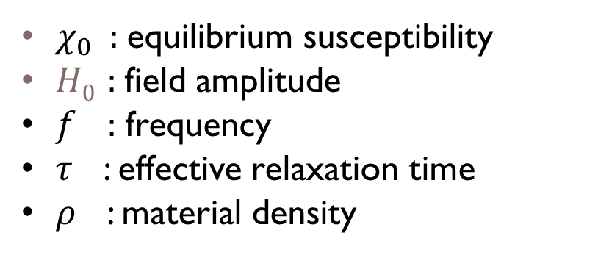
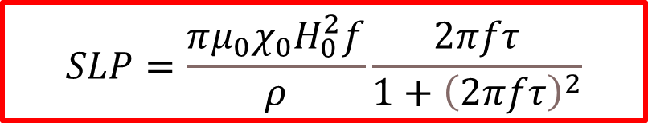
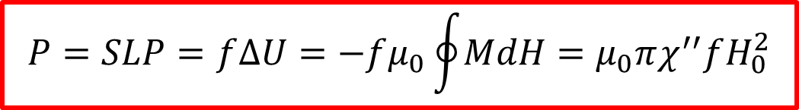
NPRM 2025
Rosensweig’s Theory for Magnetic Hyperthermia
$$P=SLP=f∆U=−fμ_{0}\oint{MdH}=μ_{0}πχ^{′′}fH_{0}^{2}$$
Accounting Shliomis relaxation
$$SLP=\frac{πμ_{0}χ_{0}H_{0}^{2}f}{ρ}\frac{2πfτ}{1+{\left(2πfτ\right)}^{2}}$$
$χ_{0}$ : equilibrium susceptibility
$H0$ : field amplitude
$f$ : frequency
$τ$ : effective relaxation time
$ρ$ : material density
Assumptions of Rosensweig’s Theory
non-interacting particles,
uniform particle properties
absence of anisotropy or shape effects
R.E. Rosensweig, Heating magnetic fluid with alternating magnetic field, Journal of Magnetism and Magnetic Materials 252 (2002) 370–374. https://doi.org/10.1016/S0304-8853(02)00706-0.
Notes:
Rosensweig’s foundational models addressed heat dissipation in magnetic fluids subjected to AMFs, highlighting hysteresis losses and relaxation mechanisms. power dissipation (P) can written 1. Accounting Shliomis relaxation equation can be rewritten as follows: but this theory have assumptions

Slide 9
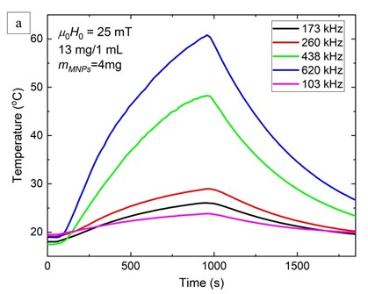
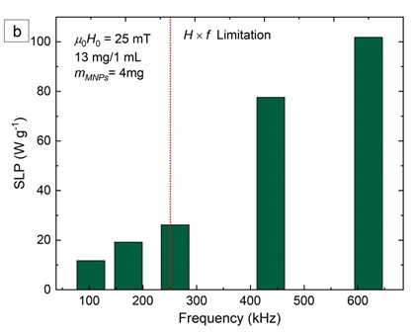
Hyperthermia curves and SLP values for constant field (25 mT)
NPRM 2025
Notes:
Two sets of experiments were conducted. In the first set, the magnetic field amplitude was kept constant (H0 = 25 mT), while the frequency ( f ) was varied by adjusting the induction coils.

Slide 10
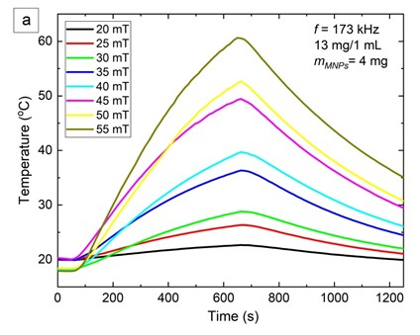
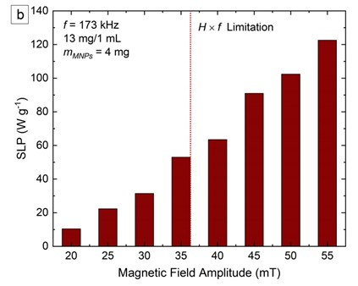
Hyperthermia curves and SLP values for constant frequency (176 kHz)
NPRM 2025
Notes:
In the second set, the frequency was held constant ( f = 176 kHz), while the amplitude of the magnetic field was varied, with the temperature-time profiles presented in Figure a

Slide 11

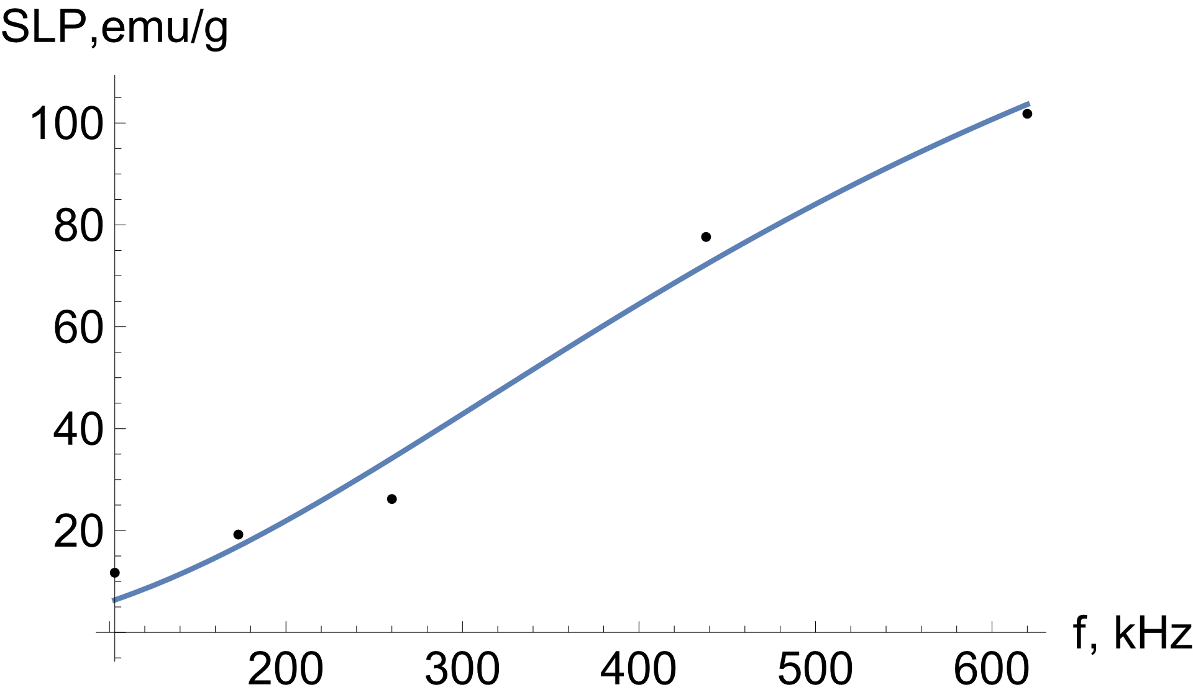


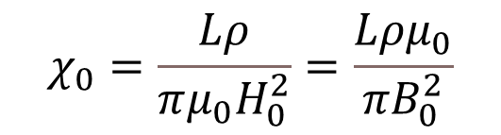

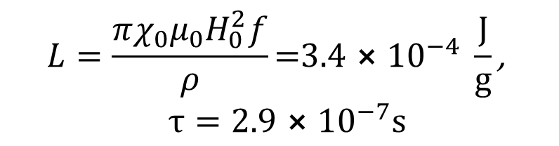
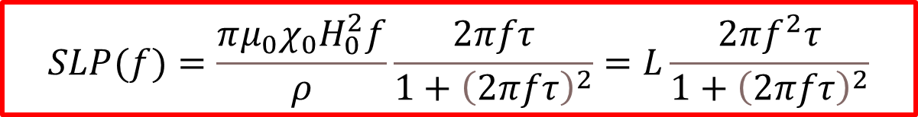
NPRM 2025
Calculating the equilibrium magnetic susceptibility (χ₀)
Method I
$$SLP(f)=\frac{πμ_{0}χ_{0}H_{0}^{2}f}{ρ}\frac{2πfτ}{1+{\left(2πfτ\right)}^{2}}=L\frac{2πf^{2}τ}{1+{\left(2πfτ\right)}^{2}}$$
$$L=\frac{πχ_{0}{μ_{0}H}_{0}^{2}f}{ρ}\text{=3.4}⨯{10}^{−4} \frac{J}{g}\text{, }$$
$$τ=2.9⨯{10}^{−7}s$$
H0 = 25 mT
$$χ_{0}=\frac{Lρ}{πμ_{0}H_{0}^{2}}=\frac{Lρμ_{0}}{πB_{0}^{2}}$$
$$χ_{0}=0.22±0.013$$
Notes:
Below present 2 methods for calculating the equilibrium magnetic susceptibility (χ0) of the core-shell nanoparticles (NPs).
Fitting the experimental data on the SLP vs f at constant field by the equation with the least
squares method we obtained the following values for L and τ, then can calculate the value for equilibrium susceptibility 𝜒0

Slide 12
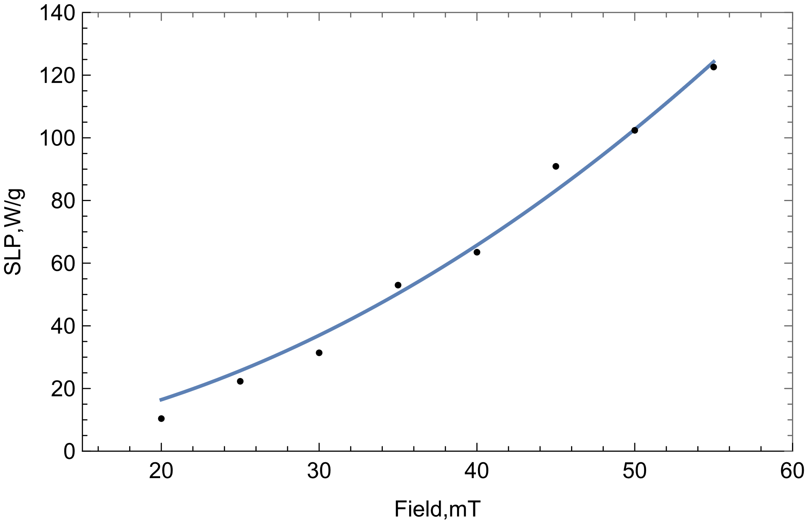
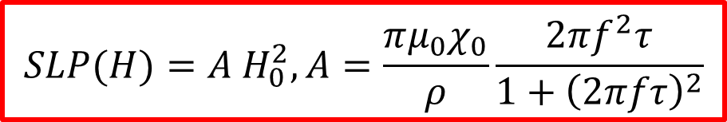
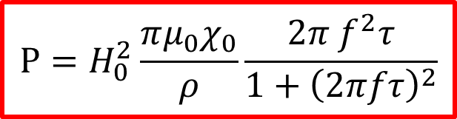
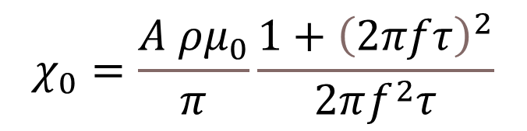
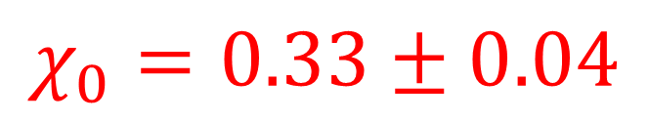
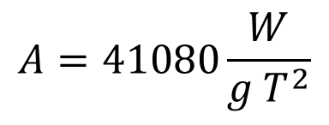
NPRM 2025
Calculating the equilibrium magnetic susceptibility (χ₀)
Method II
$$P=H_{0}^{2}\frac{π{μ_{0}χ}_{0}}{ρ}\frac{2π f^{2}τ}{1+{\left(2πfτ\right)}^{2}}$$
$$SLP(H)=A H_{0}^{2}, A=\frac{π{μ_{0}χ}_{0}}{ρ}\frac{2πf^{2}τ}{1+{\left(2πfτ\right)}^{2}}$$
f = 176 kHz
$$A=41080\frac{W}{g T^{2}}$$
$$χ_{0}=\frac{A ρμ_{0}}{π}\frac{1+{\left(2πfτ\right)}^{2}}{2πf^{2}τ}$$
$$χ_{0}=0.33±0.04$$
Notes:
We can rewrite the initial equation in the following form.
Recall that the experiment results of the SLP for different field and constant f
Approximation of these experimental data using equations allows us to estimate A value, then nnowing A we can calculate equilibrium susceptibility 𝜒0 using value for 𝜏

Slide 13
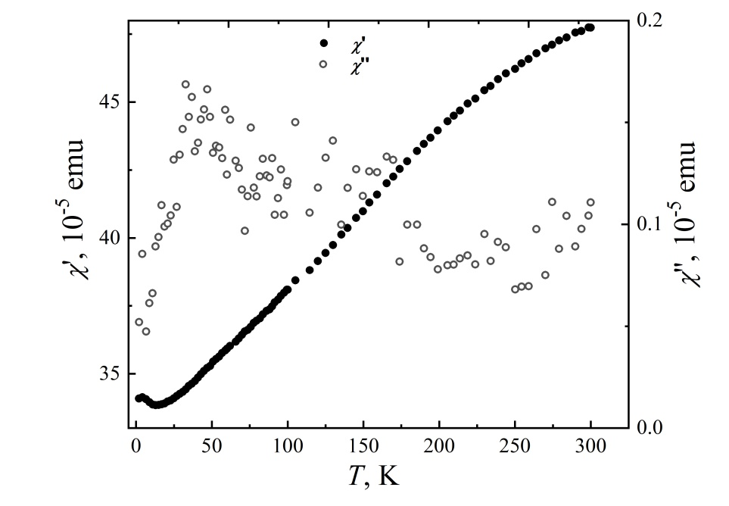
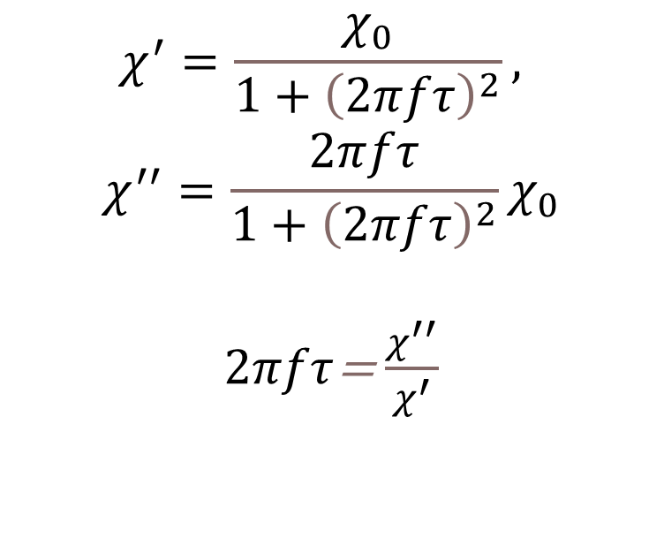
Temperature dependences of the real and imaginary parts of the magnetic susceptibility
NPRM 2025
$$χ^{′}=\frac{χ_{0}}{1+{\left(2πfτ\right)}^{2}},$$
$$χ^{′′}=\frac{2πfτ}{1+{\left(2πfτ\right)}^{2}}χ_{0}$$
$2πfτ$= $\frac{χ^{′′}}{χ^{′}}$
$$χ^{′}≫χ^{′′}$$
Notes:
1. The real (𝜒′) and imaginary (𝜒′′) parts of the equilibrium magnetic susceptibility (𝜒0 = 𝜒′ − 𝑖𝜒′′) were measured by SQUID magnetometer at amplitude of alternative magnetic field 4 Oe and frequency 100 Hz.
2. The imaginary and real parts of the magnetic susceptibility can be expressed in terms of the equilibrium susceptibility by the following equation․
3. As we can see, the real part is two orders of magnitude larger than the imaginary part of susceptibility.

Slide 14
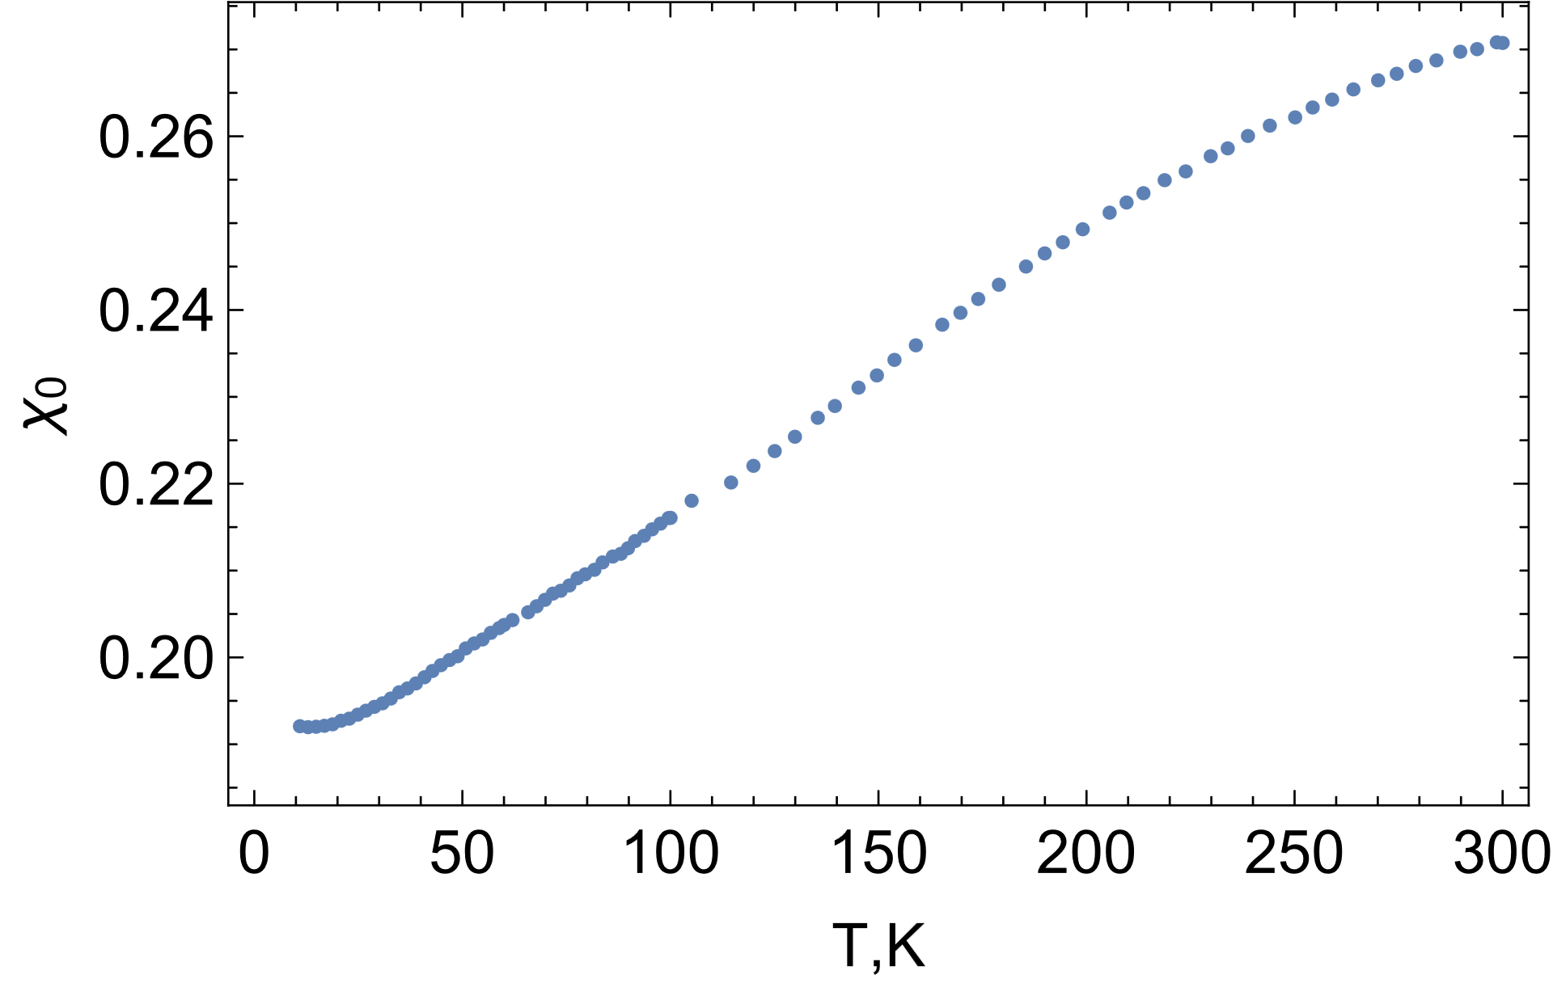
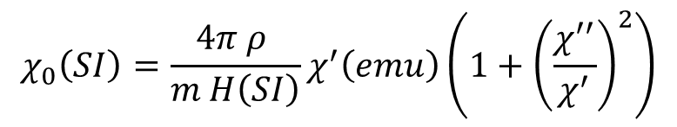
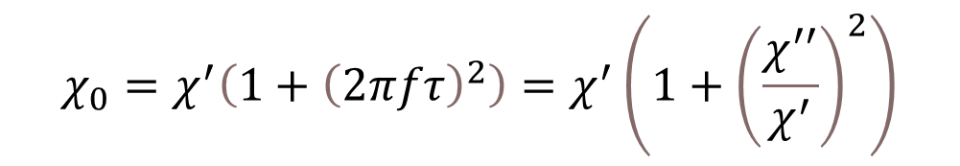
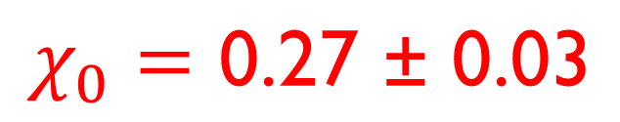
Temperature dependences of the equilibrium magnetic susceptibility (χ₀)
NPRM 2025
$$χ_{0}=χ^{′}\left(1+{\left(2πfτ\right)}^{2}\right)=χ^{′}\left(1+{\left(\frac{χ^{′′}}{χ^{′}}\right)}^{2}\right)$$
$$χ_{0}\left(SI\right)=\frac{4π ρ }{m H\left(SI\right)}χ^{′}\left(emu\right)\left(1+{\left(\frac{χ^{′′}}{χ^{′}}\right)}^{2}\right)$$
$$χ_{0}=\text{0.27 ± 0.03}$$
Notes:
1. The 𝜒0 can be represented as follows
2. Accounting the relationship between different units we obtain the following relationship and plot temperature dependences of the equilibrium magnetic susceptibility
3. Both methods yielded χ0 values that overlap with the experimental value of 0.27 ± 0.03 within their respective error margins. A good agreement between the theoretical and experimental results indicates that the assumptions underlying the employed theoretical model are valid under the investigated condition.

Slide 15
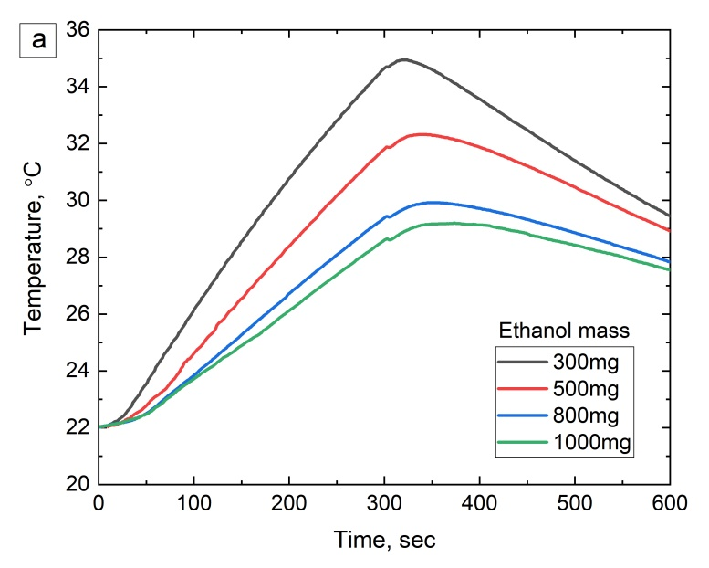
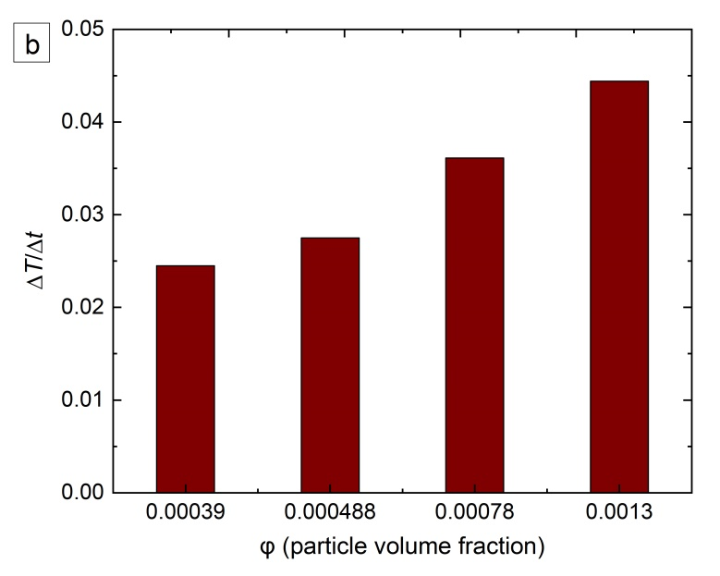
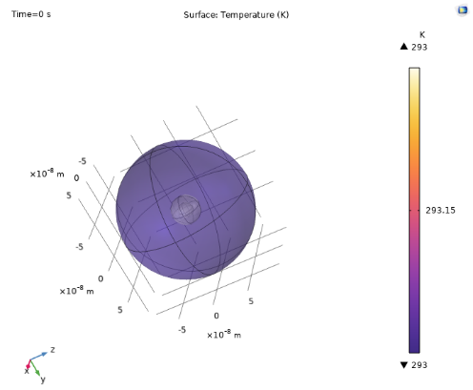
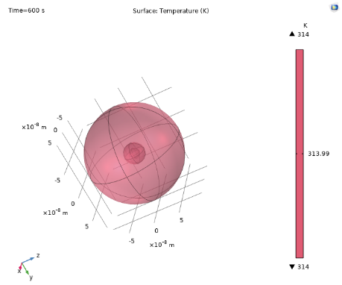
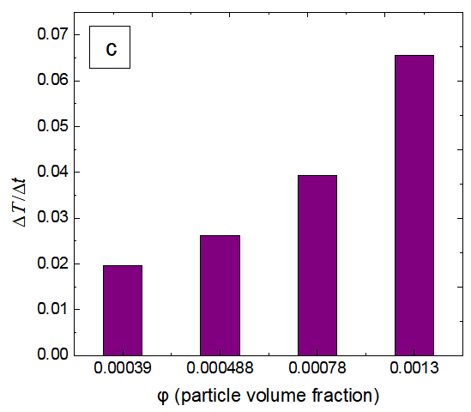
∆T/∆t values for various particle volume fraction from experiment and COMSOL
NPRM 2025
CALORIMETRY
a
b
t = 0 sec
t = 600 sec
COMSOL
Notes:
One of the assumptions used is that we may neglect magnetic interaction between the particles. To check the limits for this assumption we investigate the heating performance of suspensions with different concentration of magnetic particles. Four suspension were prepared consisting of a fixed sample mass but varying ethanol masses. Each suspension was subjected to an alternating magnetic field and corresponding ΔT/Δt values, representing the initial heating rates, were extracted for different particle volume fractions and are presented in Figure․
In parallel, a numerical model simulating of a single nanoparticle embedded in a fluid was developed using COMSOL Multiphysics to replicate the experimental conditions, ΔT/Δt values shown in the right side.

Slide 16
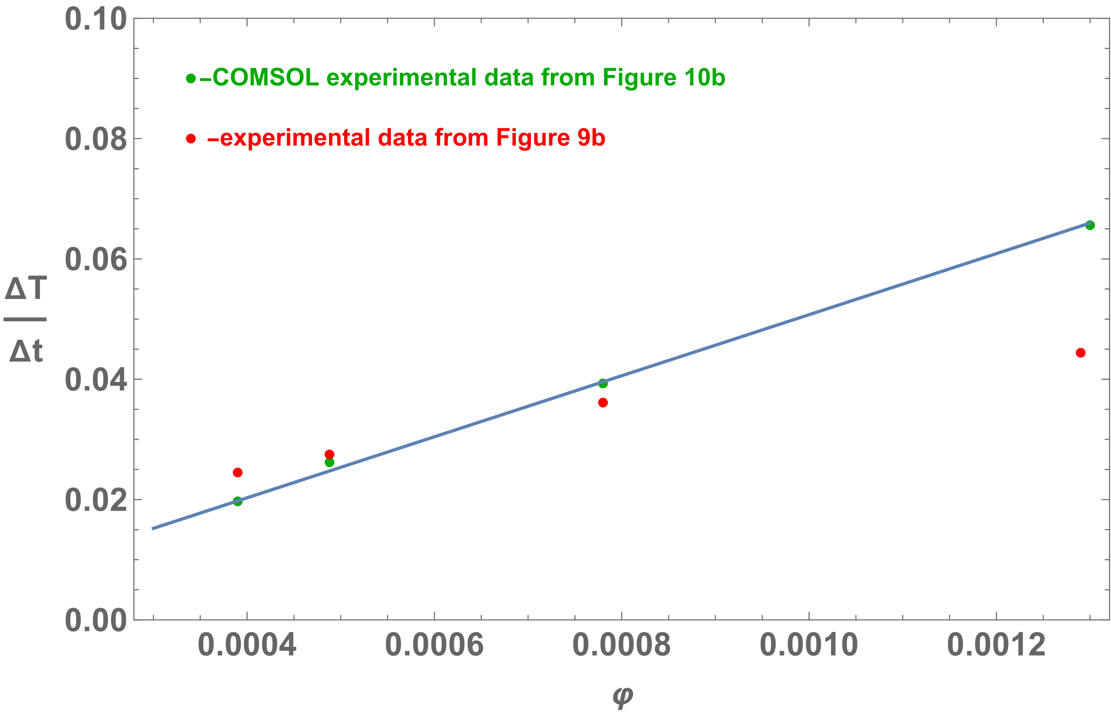
∆T/∆t values for various particle volume fraction from experiment and COMSOL
NPRM 2025
Notes:
The comparison of experimental data with simulation ones are presented in Figure․
It can seen that for lower concentrations experimental data are in very good agreement with Modeling which does not account particle interaction․ However, at higher $φ$ simulated values are higher than experimental.
The obtained results enable determination of the critical concentration in suspensions, beyond which the assumption of non-interacting particles no longer holds.

Slide 17
NPRM 2025
Conclusions
Fe–Fe₃C core–shell nanoparticles in a carbon matrix were synthesized by solid-state pyrolysis of ferrocene.
Particles: ~20 nm diameter with a ~1.5 nm graphite shell; Fe : Fe₃C ≈ 2:1.
Magnetic properties: M_{s} = 135 emu/g_{𝑚𝑒𝑡𝑎𝑙}​, H_{c} = 287 Oe at room temperature.
Hyperthermia: SLP measured under 20 – 55 mT and 103 – 620 kHz AMF conditions.
Relaxation time: τ = 2.9 × 10⁻⁷ s (from Rosensweig theory).
Equilibrium susceptibility: χ₀ = 0.22–0.33 (theoretical), χ₀ = 0.27 (experimental), in good agreement.
COMSOL model reproduced concentration-dependent SLP, validating experiments.

Slide 18




NPRM 2025
Acknowledgment
Marina Spasova
Michael Farle
Aram Manukyan
Armenuhi Sargsyan
Alexander Mukasyan
Roman Morgunov
Notes:
I would like to express my gratitude to my colleagues for their invaluable contributions, guidance, and support of this work.
Their expertise and dedication have been essential to the successful completion of this study.

Slide 19
NPRM 2025
Thank You For Your Attention

Slide 20
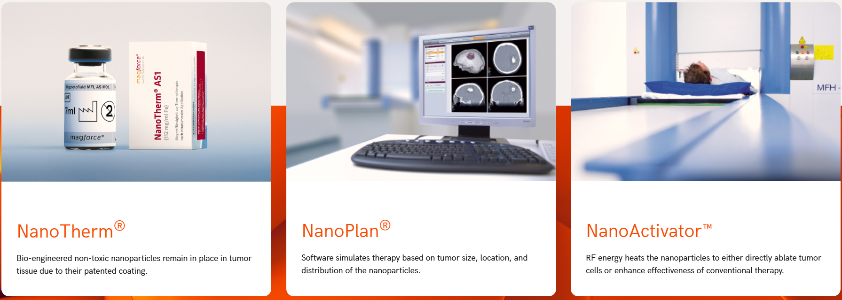
Magnetic Particle Hyperthermia (MPH)
https://www.nanothermtx.com/

